Slide 1
ROUND 2 SEGMENT 3

Slide 2
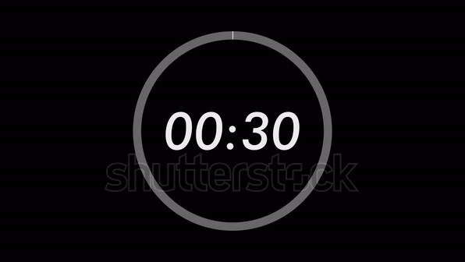
1. Gray code is a ________ code (weighted/non-weighted)

Slide 3
2. What is the SI unit of Magnetic flux?

Slide 4
3. Who discovered the photoelectric effect?

Slide 5
4. The opposition to AC current in a circuit is called ____

Slide 6
5. A material with zero electrical resistance is called a ____

Slide 7
6. What is the binary equivalent of decimal number 23?

Slide 8
7. The Fourier Transform converts a time-domain signal into a ____ domain signal.

Slide 9
8. What should be the range of the voltage gain for a wien's bridge oscillator?

Slide 10
9. What is the power factor of a purely resistive circuit?

Slide 11
10. A system whose output depends only on the present and past inputs is called ____

Slide 12
11. What type of feedback is used in oscillators?

Slide 13
12. What is the typical efficiency range of a Class B amplifier?

Slide 14
13. What is the main loss in a transformer?

Slide 15
14. What is the maximum theoretical efficiency of a full-wave rectifier?

Slide 16
15. What is the advantage of MOSFET over BJT?

Slide 17
16. What is the typical voltage level of TTL logic '1'?

Slide 18
17. What is the purpose of bypass capacitor?

Slide 19
18. Which amplifier class has the highest efficiency?

Slide 20
19. What is the function of a Schottky diode?

Slide 21
20. What is the range of a typical ultrasonic sensor?

Slide 22
21. What is the typical bandwidth of an ideal op-amp?

Slide 23
22. Which register holds the address of the next instruction to be executed?

Slide 24
23. What does DMA stand for in microprocessor systems?

Slide 25
24. What is the full form of SPI?

Slide 26
25. What is the frequency range for FM radio?

Slide 27
26. ______ resets to zero after reaching its maximum value

Slide 28
27. A signal that has energy concentrated within a specific frequency range is called a _______ signal.

Slide 29
28. The phase shift introduced by an ideal capacitor in an AC circuit is ____

Slide 30
29. An amplifier's frequency range is set by its _______

Slide 31
30. A ______ operates via quartz vibrations

Slide 32
31. A ______ circuit increases voltage using diodes and capacitors

Slide 33
32. The Q factor is the resonant frequency to ____ bandwidth ratio.

Slide 34
33. The BJT's current gain (β) is the C-B current ratio in the ____ region

Slide 35
34. The inverting amplifier's input impedance depends on ____

Slide 36
35. The 555 timer operates in ______ mode to generate pulses

Slide 37
36. What are the feedback elements used in a Colplitts oscillator?

Slide 38
37. The magnetic field inside a solenoid is ________ (uniform/non-uniform).

Slide 39
38. The Laplace Transform converts a time-domain function into the ____ domain.(s)

Slide 40
39. What should be the phase shift per stage in a three-stage RC phase shift oscillator?

Slide 41
40. What is the advantage of an op-amp over a transistor amplifier?

Slide 42
41.What is the function of a varactor diode?

Slide 43
42. The Z-transform is used for analyzing ____ domain signals.

Slide 44
ROUND 2 SEGMENT 3

